Slide 1
ACT for ENVIRONMENT

Slide 2
KA2 ERASMUS+ PROJECT (1/9/2020 – 31/8/2022)
GREECE
SPAIN
ROMANIA
PORTUGAL
CROATIA

Slide 3
PROJECT GOALS
educate and raise awareness about our responsibility to slow down the side effects of technical progress
change individual and collective behaviour through sustainable consumption and sustainable living
educate our students to become active and more responsible citizens so that they can understand the importance and value of our natural resources

Slide 4
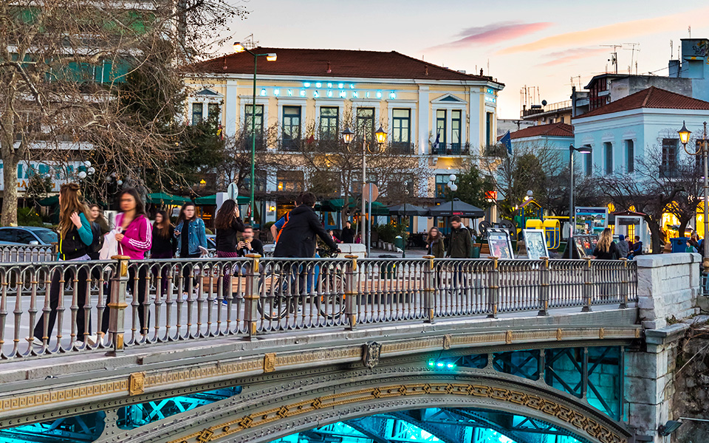
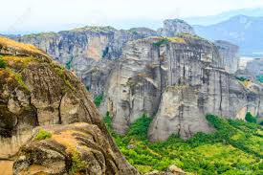
Recycling as the first step
questionnaire about environmental problems
how to to face climate change
recycling as a way of decreasing the climate change effects
outdoor environmental activities to Natura Area of Pindos
1 Epal Trikalon, Trikala, Greece

Slide 5
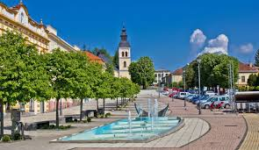
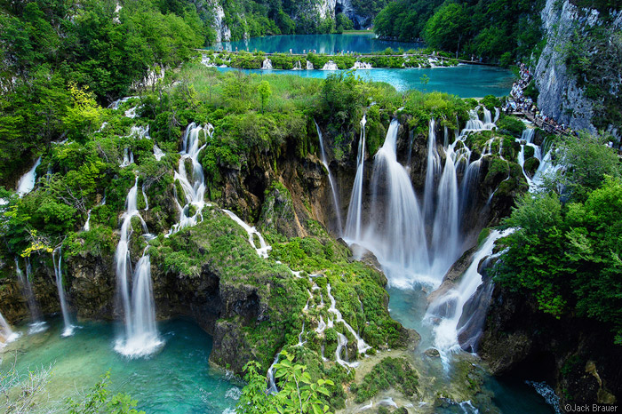
Mass consumerism society
survey on consumerism – needs vs.wants
workshops on: How much is enough? and Propaganda use in advertising
consumerism and holidays
Plitvice Lakes hike
Ekonomska i turistička škola Daruvar, Croatia

Slide 6
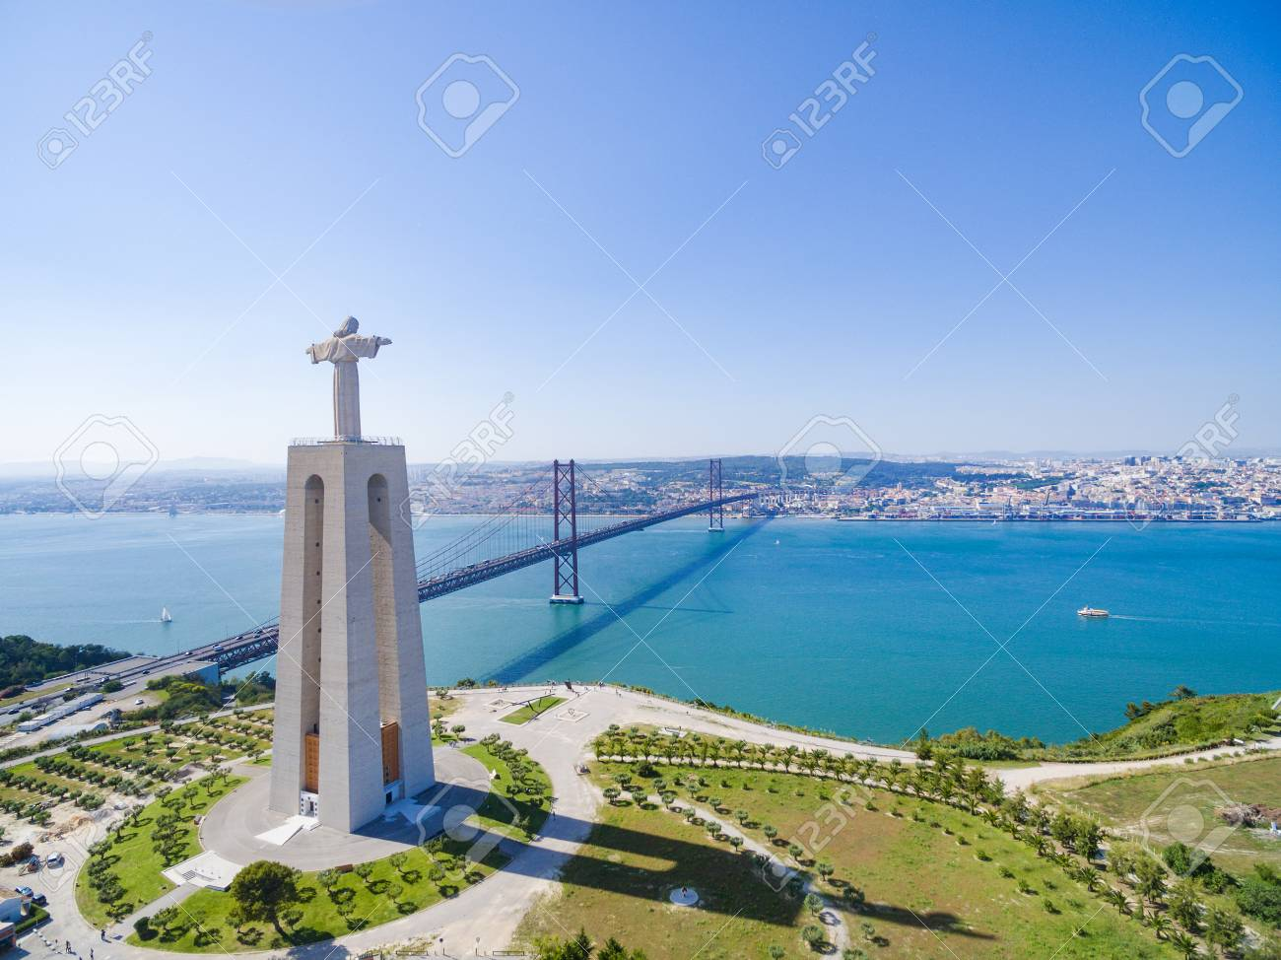
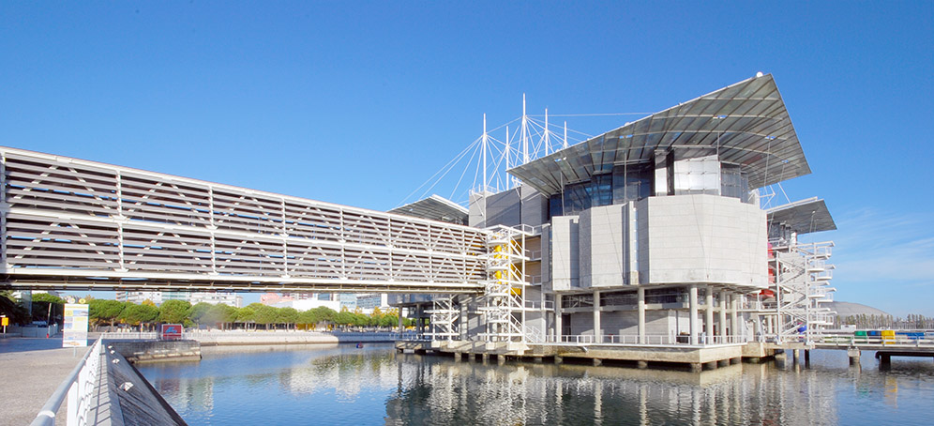
One week between the river and the sea
identify microplastics in health and hygiene products
cleaner beaches - analyze and separate the litter found on the beach in Costa da Caparica
how to change the use of plastic
Marine Plasticology in Oceanário de Lisboa
Agrupamento de Escolas Anselmo de Andrade, Almada, Portugal

Slide 7
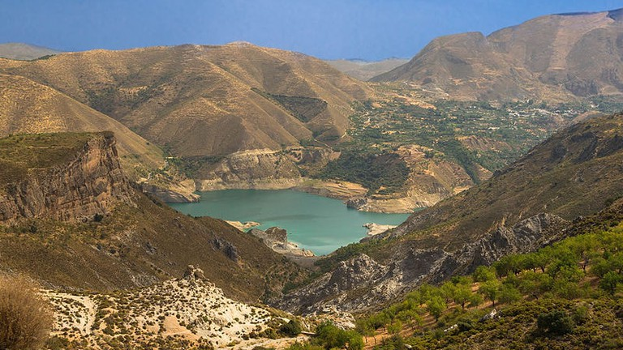
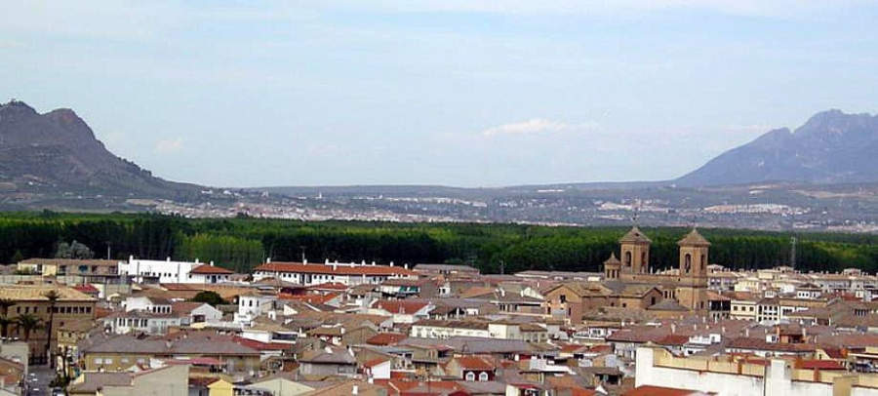
Climate change and Biodiversity
climate change and Biodiversity
visit to the Science Park of Granada: Birds of prey Workshop and BioDomo, a window to life
a hike along “La Vereda de la Estrella” in the Sierra Nevada National park
IES Hispanidad, Santa Fe, Spain

Slide 8
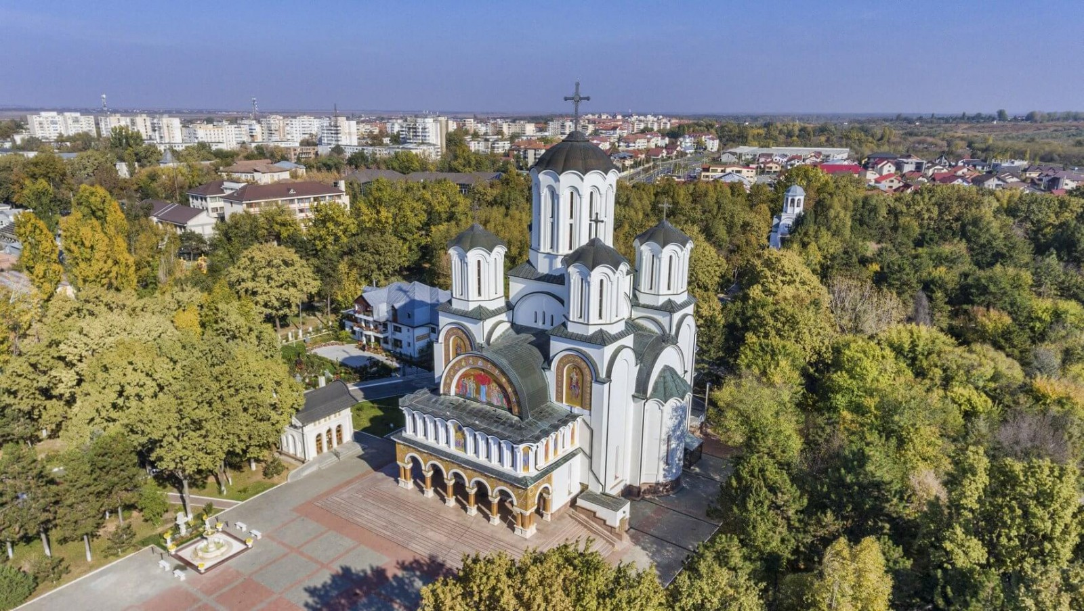
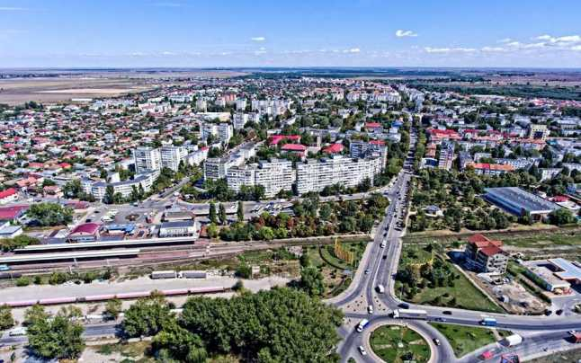
Saving energy and the environment
renewable energies
an open air workshop - how to apply renewable energy in our homes
debates concerning environmental issues
presentation of the project’s outcomes and results
1 Liceul de Arte "Ionel Perlea", Slobozia, Romania

Slide 9
ACT for ENVIRONMENT!

