Slide 1



LET IT START WITH ME
by Romana Zelda
Portugal mobility

Slide 2
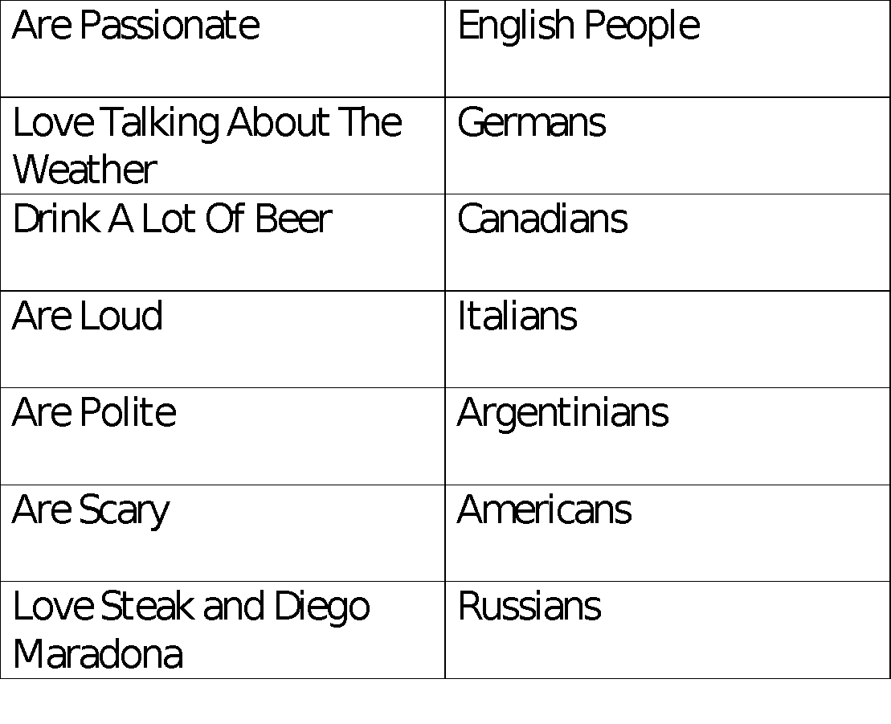

Slide 3
STEREOTYPES
“... Images in our minds”
- a generalized belief about a particular category of people
- it is an expectation that people might have about every person of a particular group

Slide 4
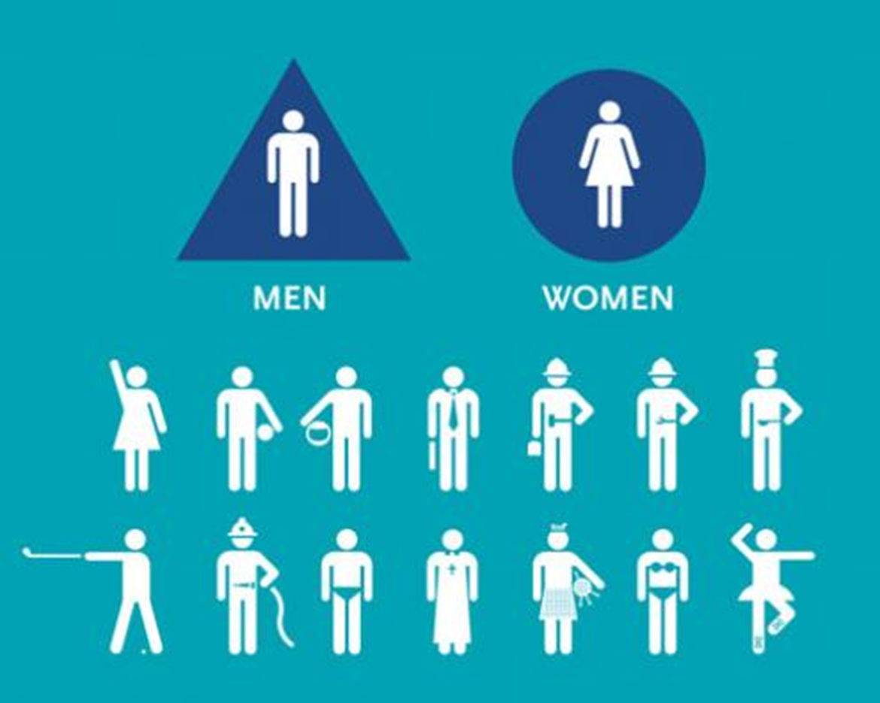

Slide 5
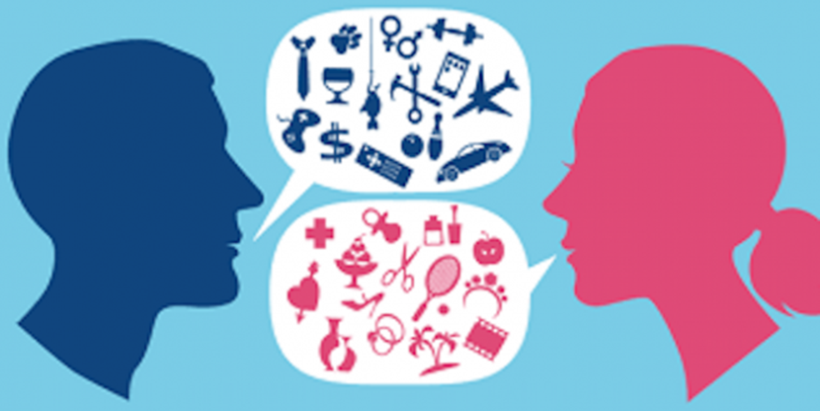

Slide 6
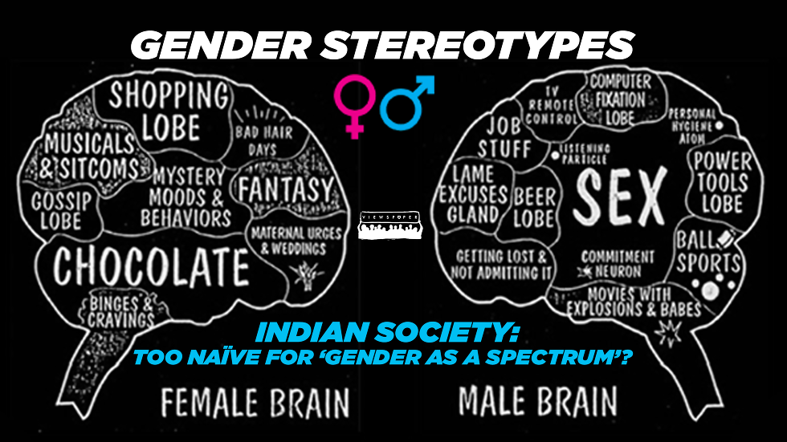

Slide 7
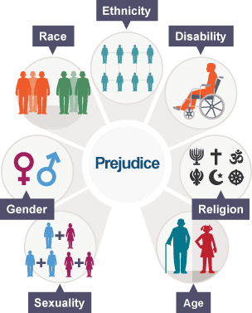
PREJUDICE
an affective feeling towards a person based on their perceived group membership

Slide 8
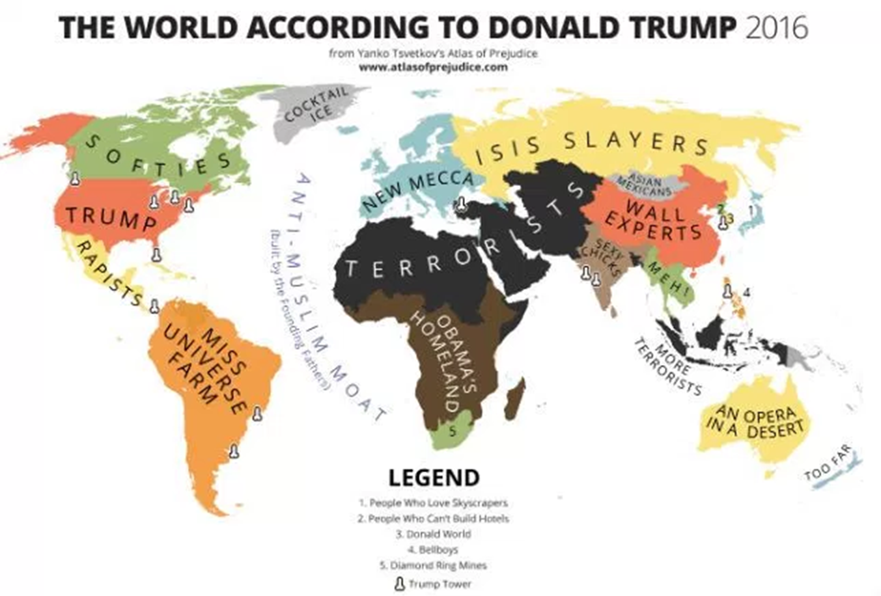

Slide 9
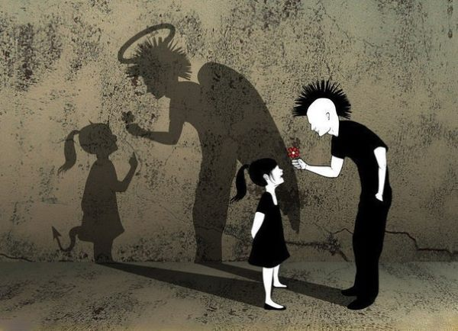

Slide 10
DISCRIMINATION
is the unfair or prejudicial treatment of people and groups based on characteristics such as race, gender, age or sexual orientation

Slide 11
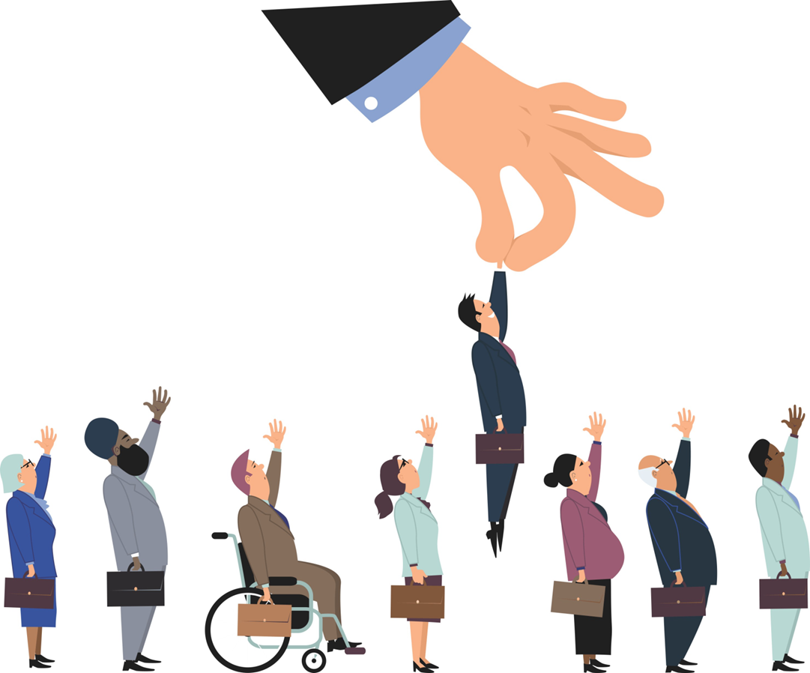

Slide 12
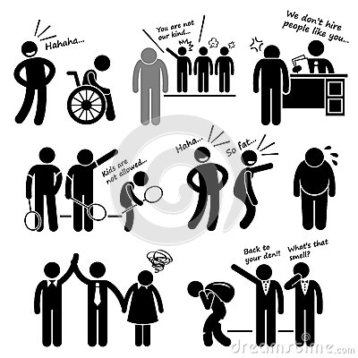

Slide 13
ETIQUETTE

Slide 14
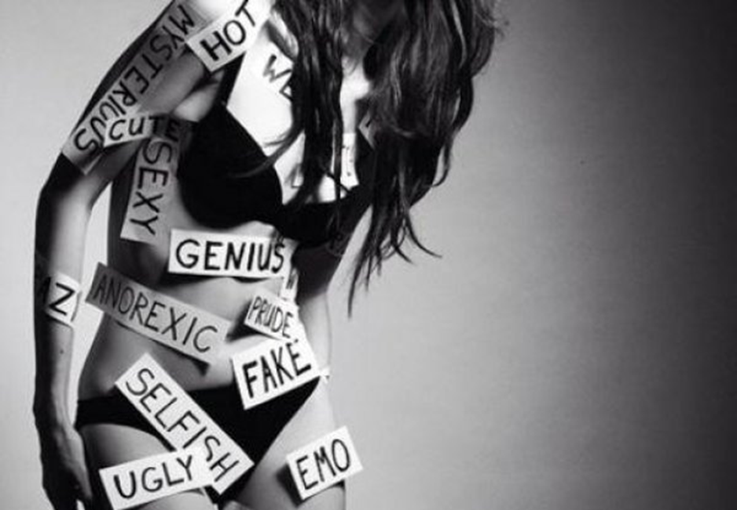

Slide 15
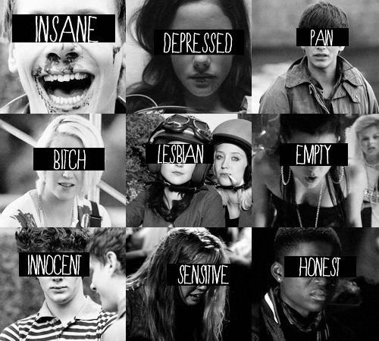

Slide 16
SUBCULTURE
a group of people within a culture that differentiates itself from the parent culture to which it belongs, often maintaining some of its founding principles

Slide 17
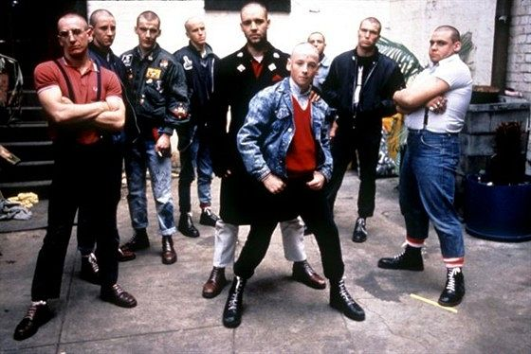
SUBCULTURE

Slide 18
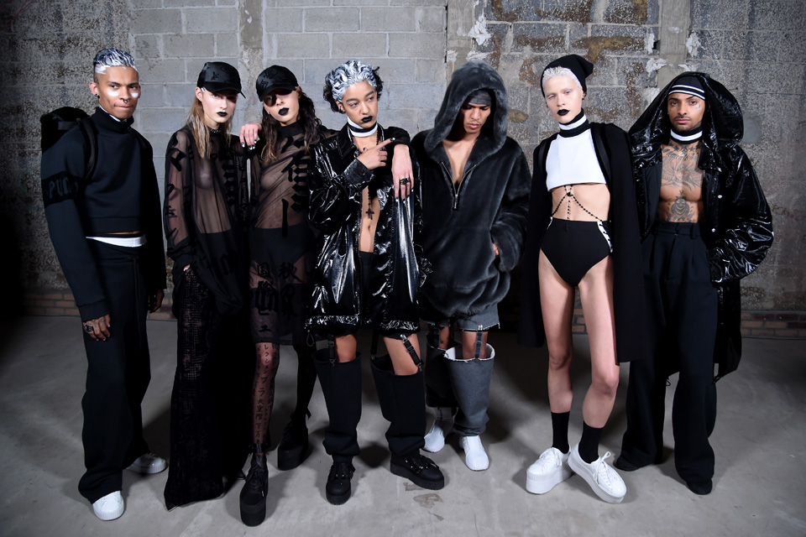

Slide 19
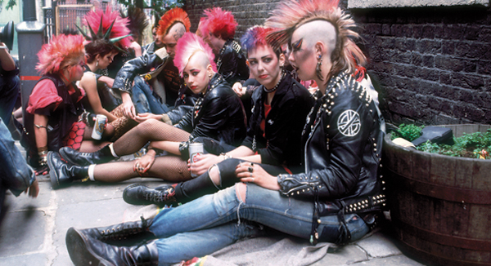

Slide 20
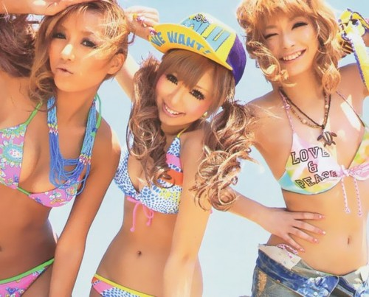

Slide 21
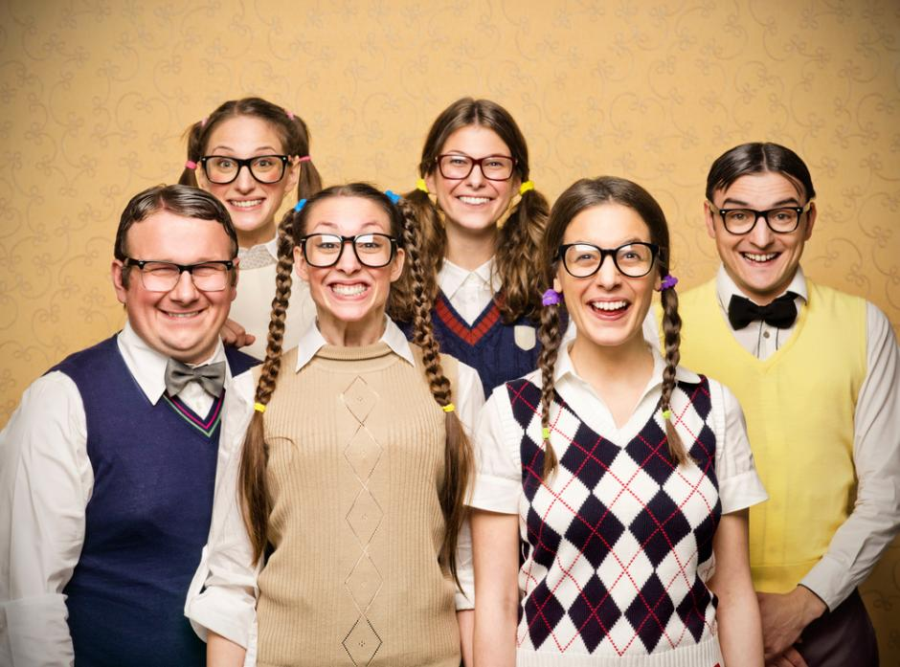

Slide 22
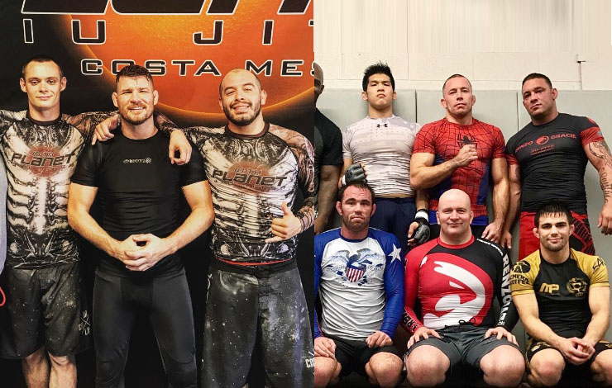

Slide 23
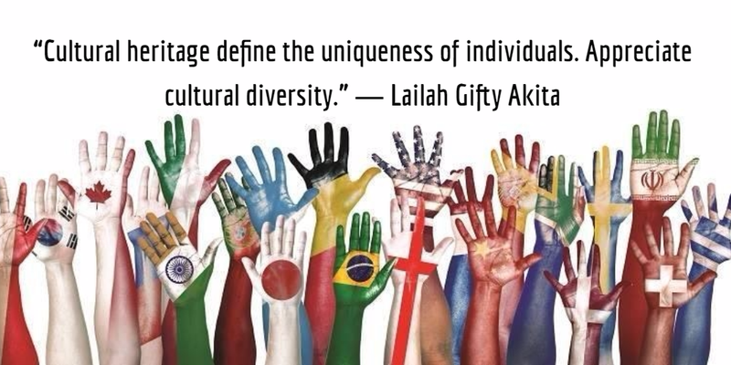
DIVERSITY

Slide 24
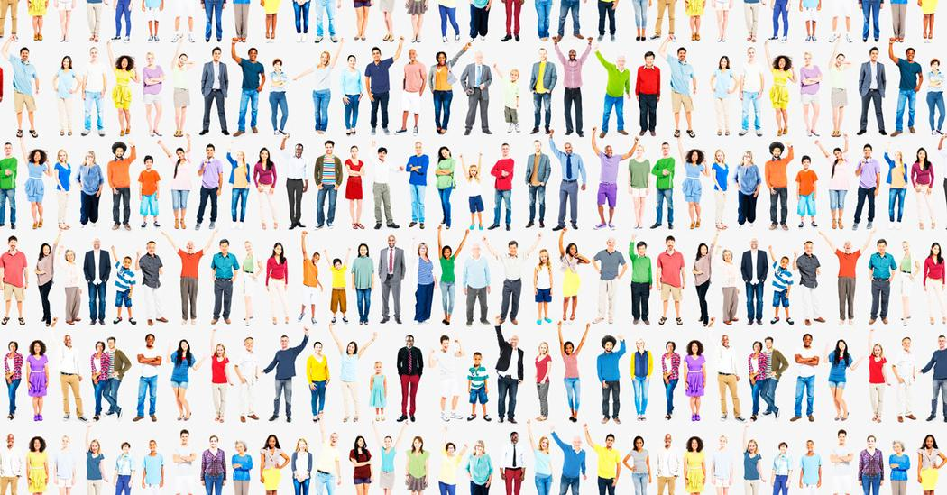

Slide 25
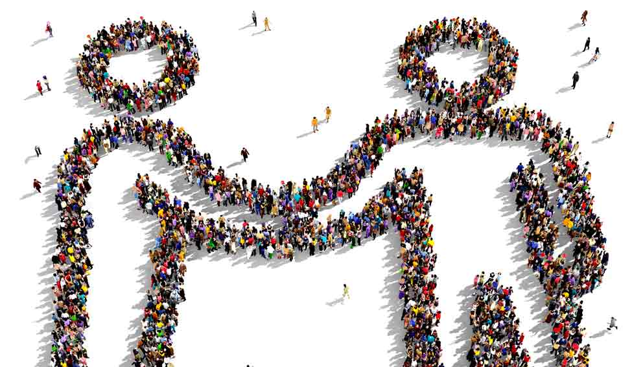
TOLERANCE

Slide 26
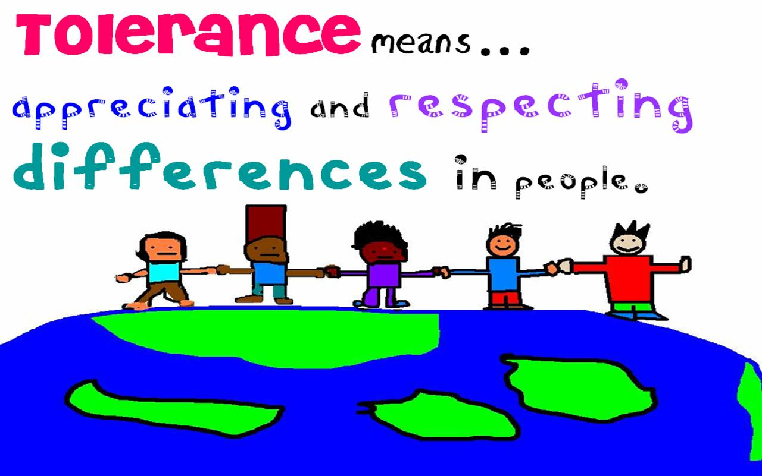

Slide 27
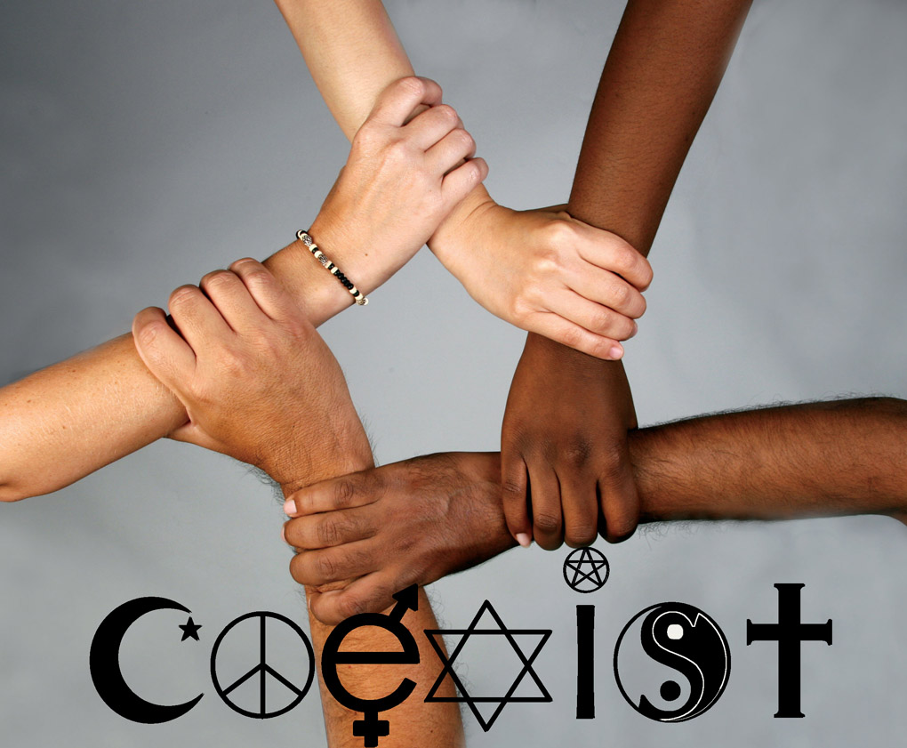

Slide 28


Slide 29
INCLUSION?

Slide 30
WORKSHOP
DIFFERENT BUT SIMILAR

Slide 31
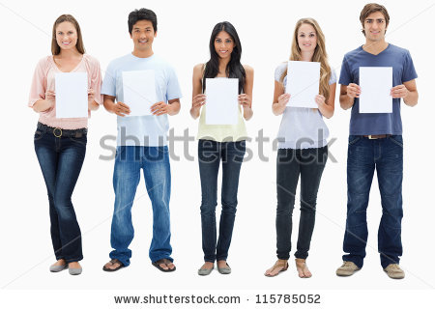

Slide 32
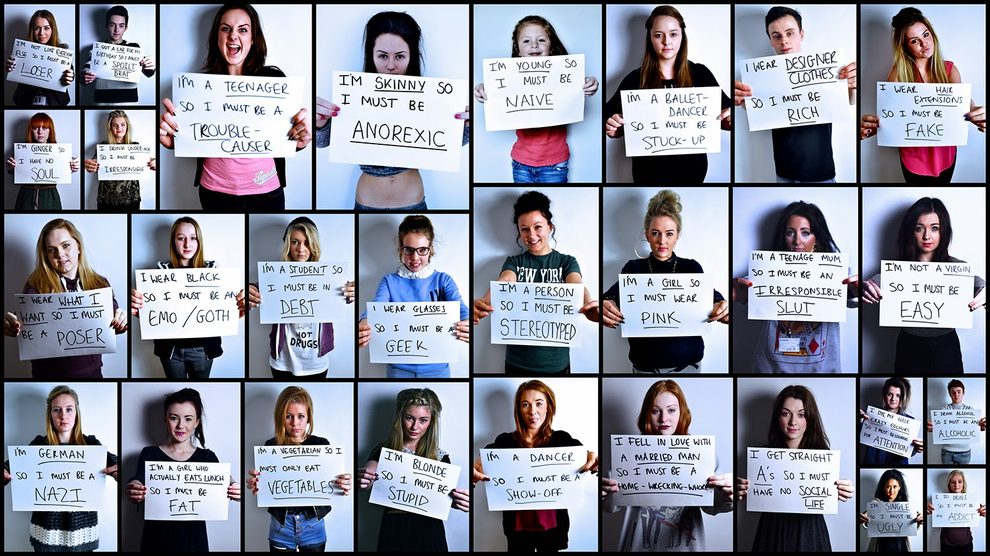

Slide 33
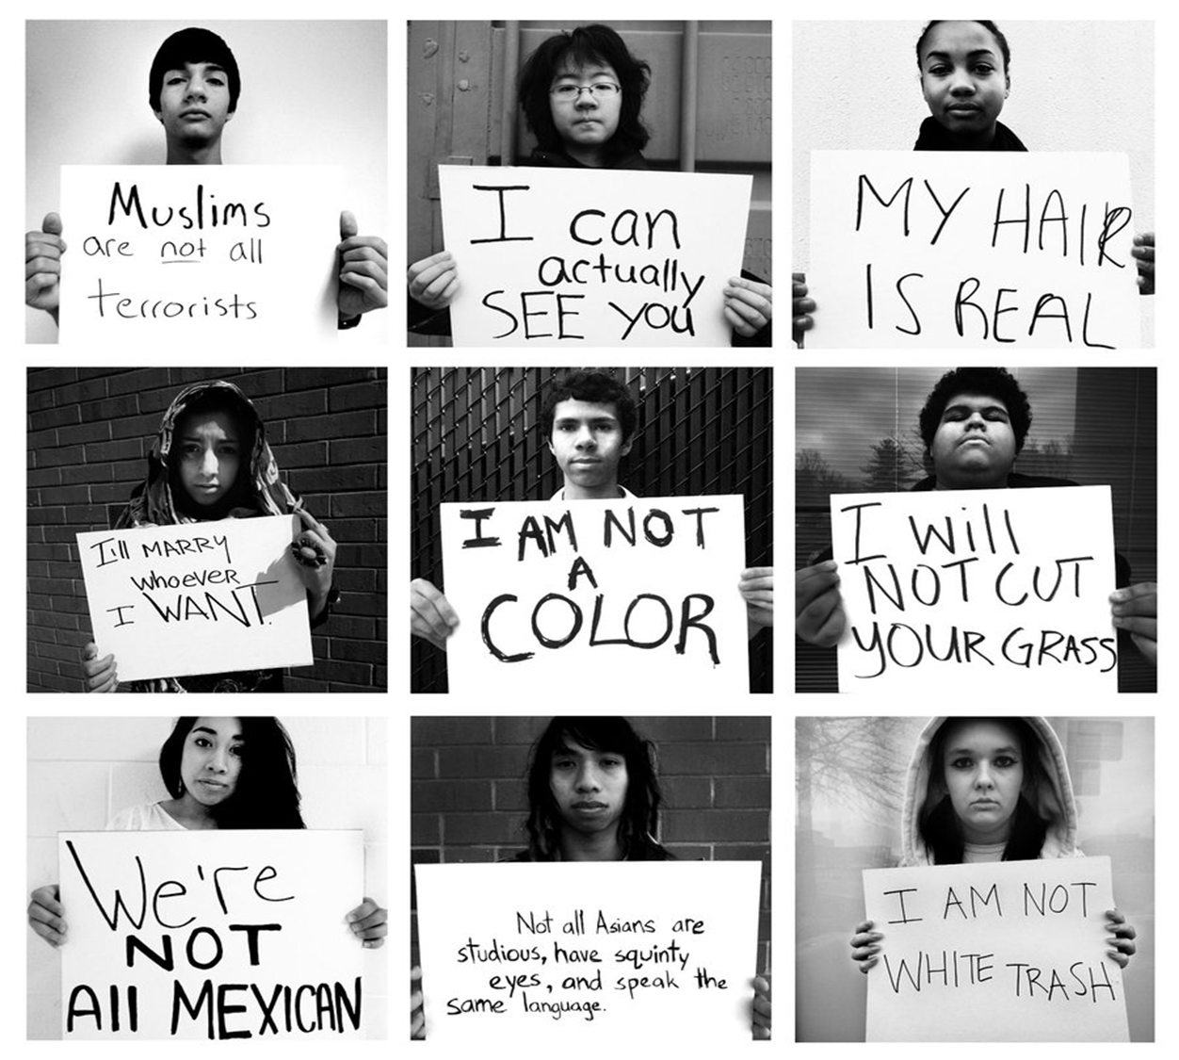

Slide 34
https://www.youtube.com/watch?v=GX3Ivxn8tXA
VIDEO – HOMELESS PERSON – 5.33 MIN

Slide 35
TOLERANCE
LET IT START WITH ME

Slide 36
What is my name?
Where do I live and who with?
What do I do?

Slide 37
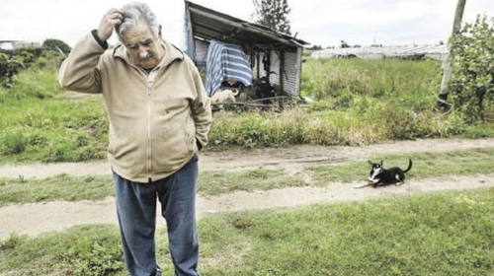

Slide 38
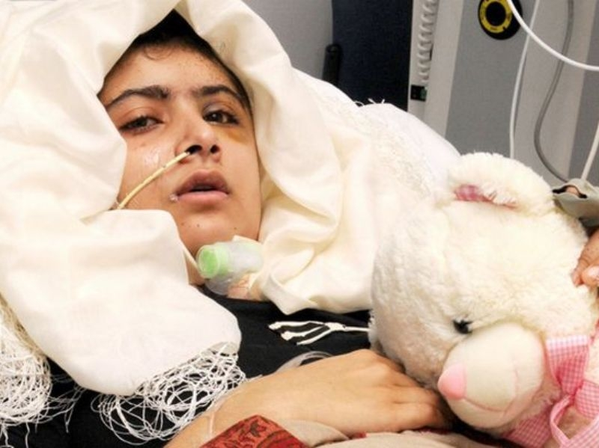

Slide 39
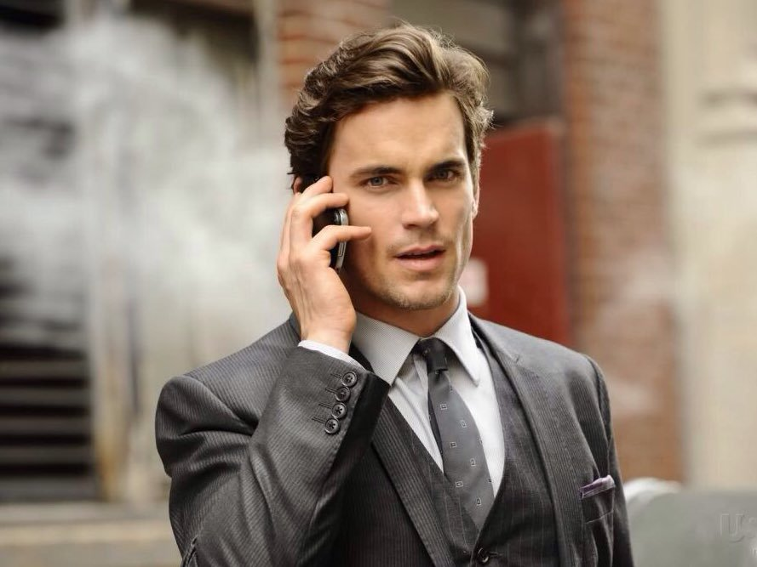

Slide 40
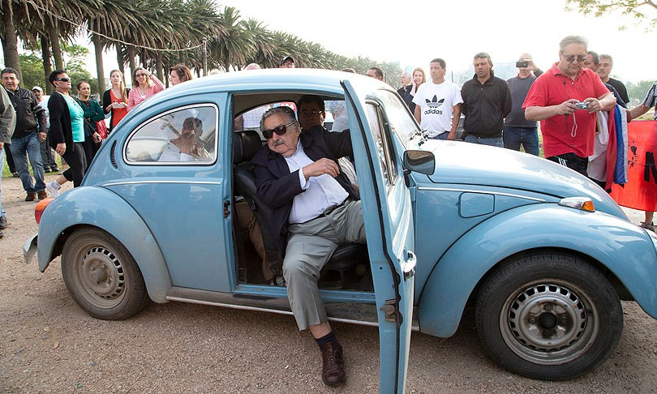
Jose Mujica
is a Uruguayan politician and farmer who served as the 40th President of Uruguay from 2010 to 2015
He has been described as "the world's humblest head of state" due to his austere lifestyle and his donation of around 90 percent of his $12,000 monthly salary to charities that benefit poor people and small entrepreneurs

Slide 41
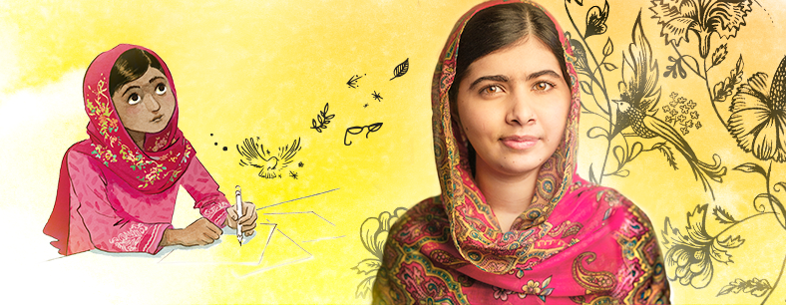
Malala Yousafzai
Born 12 July 1997, a Pakistani activist for female education and the youngest Nobel Prize laureate, known for human rights advocacy, especially the education of women and children in her native Swat Valley in Khyber Pakhtunkhwa, northwest Pakistan, where the local Taliban had at times banned girls from attending school

Slide 42
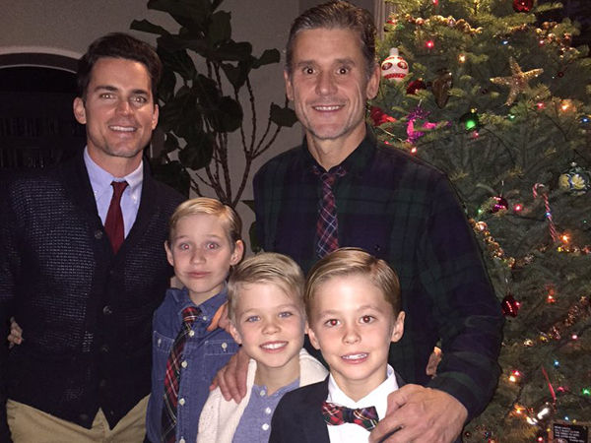
Matt Bomer
Known as Neil on “White Collar” has actually been married to a man since 2011, and raised three kids together.

Slide 43
QUIZ
Stereotypes are distorted image one group has about the others
Prejudice is a positive attitude towards other poeple
Discrimination is a violation of other poeple’s rights
Etiquette is putting a tag on people
Subculture is something bad
Diversities are beautiful
Tolerance is accepting differences
1. YES / NO
2. YES / NO
3. YES / NO
4. YES / NO
5. YES / NO
6. YES / NO
7. YES / NO

Slide 44
Thank you for your attention!
We hope the change will start with YOU!

