Slide 1

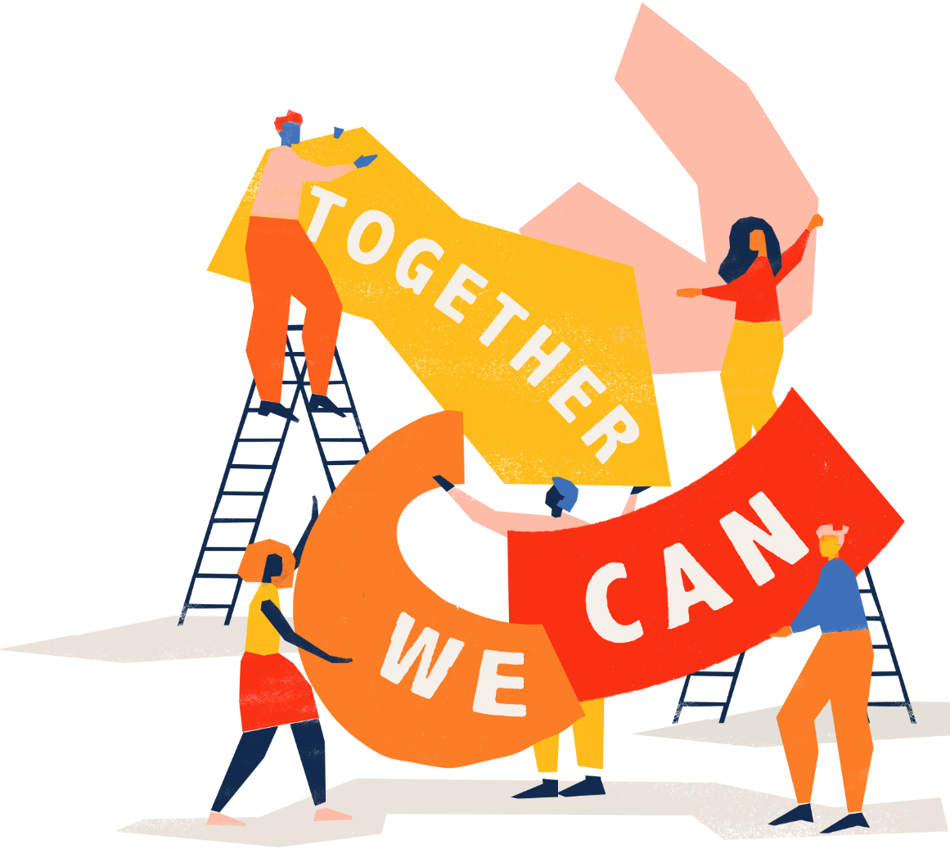

We are awesome
together

Slide 2

https://youtu.be/2FCwiVrJdHE?si=CDxIJ_lonKvXmw6X

Slide 3

1. Invisible clay
Communication is much more than words.
Imagine how is it like to be unable to communicate through spoken language.
Use gestures and facial expression.

Slide 4

Were you surprised that you have been able to work out what the object was with no speaking?
What were the challenges?
What were the most useful non-verbal ways to communicate?
How this could be used when communicating with someone who could not speak?

Slide 5
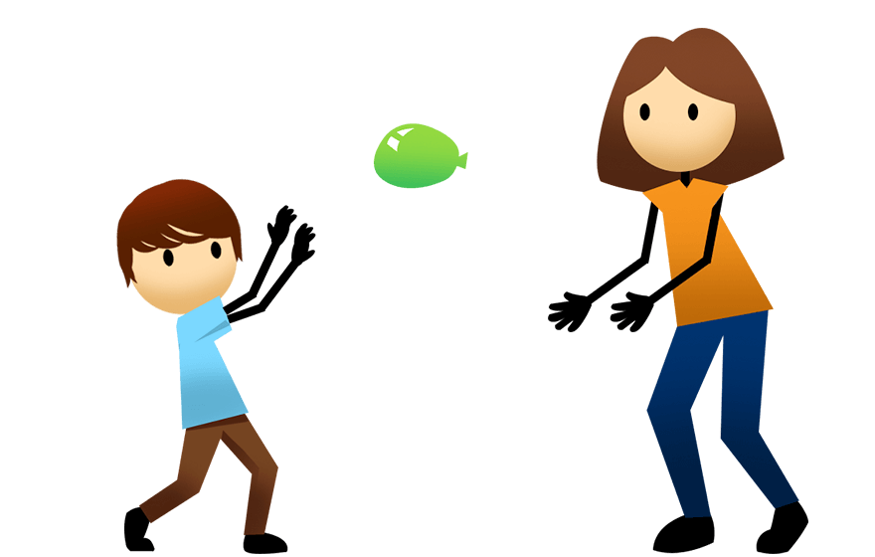
2. Balloon volleyball
This game will help you to understand how it might feel to be excluded and how to adapt an activity to ensure it is inclusive.

Slide 6

Did you feel like you were equally involved in the game when you were sat on the chair or on the floor?
Did you find it frustrating when you were in different positions?
Did you try to include everyone in the team?
Think of a way you could try to make the game more inclusive for
those on the floor and chairs.

Slide 7
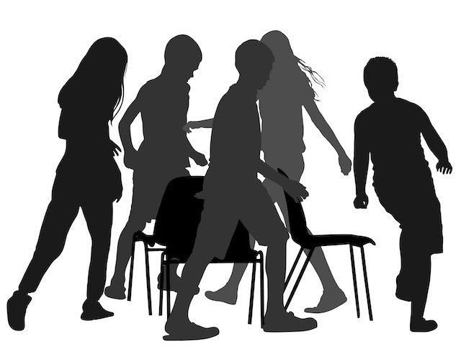
3. Reverse musical chairs
In this game you will have to work hard to include everyone in the group.

Slide 8

What did you liked about the game?
How it feels to be excluded from a game?
Why might a disabled person be excluded?
Think about other games that traditionally exclude people, which could be adapted to include people.

Slide 9
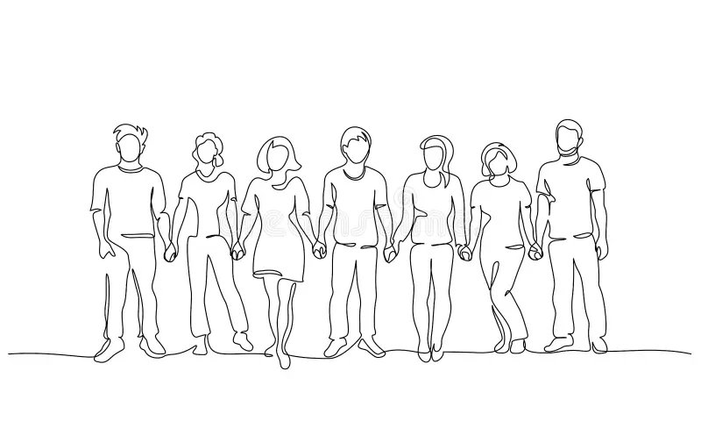
4. Silent line-ups
This activity helps the group to understand that they can communicate with each other without speaking.
You will work out how to line up cooperatively using gestures, facial expressions, nods, etc.

Slide 10
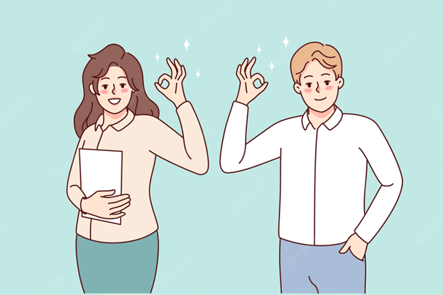
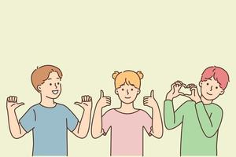
Was the game easy or hard ?
What are some other ways that you might communicate with a person who is not able to speak?

Slide 11


